Slide 1
Staff Profiles

Slide 2
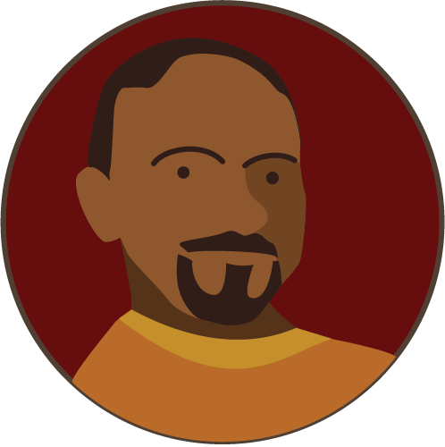
Marcos Serna
Farm General Manager
Grew up near Yakima, WA
A “barbeque fanatic”
Notes:
Marcos Serna grew up on his family's farm near Yakima, WA. When an accident limited his father's ability to work, Marcos and his older brother quickly learned how to keep things humming on the farm. His older brother also had some other ideas about how to run the farm. "My older brother saw an opportunity to change things and my father was opposed to it, so there was some conflict there. But after the accident, we started moving towards being an organic farm, and it worked out well for us. Eventually, my father came around." After proving himself on the family farm, Marcos began looking for opportunity elsewhere and soon discovered Munson's. He became General manager five years ago. A self-described "barbeque fanatic", Marcos makes a skirt steak that will change your life. His Treasured and hard-working 1947 pickup truck is a big people magnet at farm events.

Slide 3
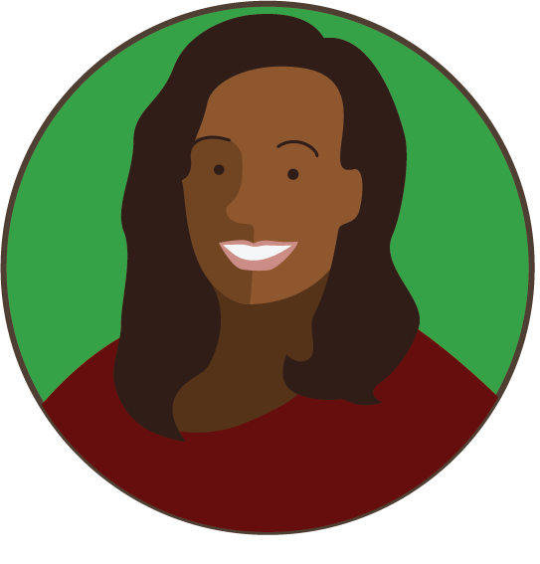
Eugenia Austin
Soil Scientist
Grew up in Boulder, CO
Enjoys crossword puzzles, photography, and is a ferocious scrabble player
Notes:
Eugenia Austin grew up in Boulder, CO, the daughter of an elementary school teacher and a postal administrator. A shy, disciplined student, she became interested in biology in high school. Her class took a field trip to a farm in the 10th grade. "Of course, I'd seen a farm before, but really only out the window of a car. I didn't know anyone who lived on one. So here we were in all our edgy high-school glory and the man showing us around, this was a flower nursery, he makes us dig our hands into the soil and cup our hands full of dirt and lift it up and smell it! It hit me in a second. This is why we can survive on this planet." She eventually got an PhD in Agronomy. When she's not at work, she enjoys crossword puzzles, photography, and is a ferocious scrabble player.

Slide 4
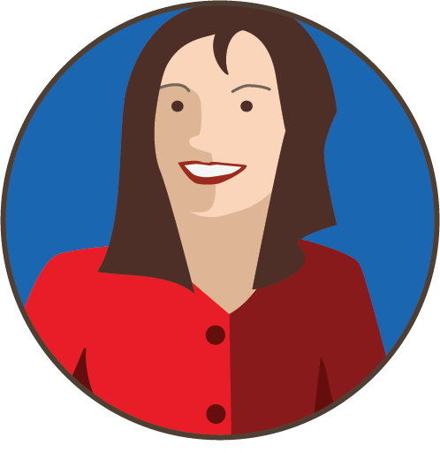
Fen Long
Irrigation Engineer
Worked at the United States Bureau of Reclamation
"Really, I'm a math person"
Notes:
"Really, I'm a math person" says Fen Long. Always good at numbers and in love with the freeways of her Los Angeles childhood, Fen decided to become a civil engineer. As she studied further, she realized that she was fascinated by the flow of water and how to manage it, another issue troubling LA. After a dissertation on the irrigation history of the Phoenix, AZ region, she worked at the United States Bureau of Reclamation. Work at the Bureau led to an opportunity as a consultant on irrigation and drainage matters. One of her clients was a farmer. Visiting the farm changed her life. "I was sick of being in an office juggling numbers when here was this farm actually doing the work. I could drive a tractor and grade a field for proper drainage. I could adjust sprinkler flow rates for soil composition. I could really affect the world, one field at a time." Fen is now the proud irrigation engineer at Munson's Pickles and Preserves Farm.

Slide 5
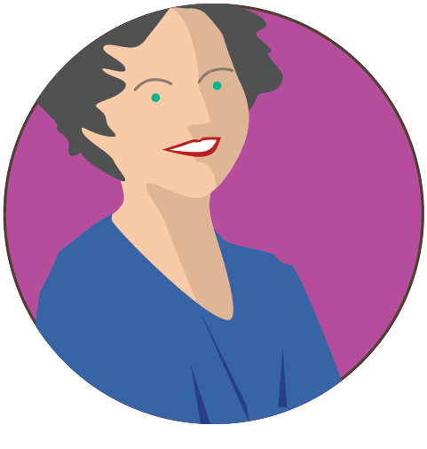
Hilary Brennan
Greenhouse Manager
Grew up on army bases as her dad’s military assignments changed
Loves to travel and recently returned from two weeks in Iceland
Notes:
Hilary Brennan was "what they call an Army brat,” she jokes. She was always moving from army base to army base as her dad’s military assignments changed. She started keeping small potted plants indoors at an early age. "We couldn't have a garden because we weren't in any one place long enough to make it worthwhile." She discovered she had a knack for making plants grow. Her first job at a flower stand led to work at a plant store, a nursery, and now Munson's Farm. "When I started here, I was terrified inside because it was my first real managerial position, but the people here are really supportive and I quickly felt at ease." Her second year at the greenhouse was the most productive in Munson's history. Despite the rootless feeling of her youth, Hilary loves to travel and recently returned from two weeks in Iceland.

Slide 6
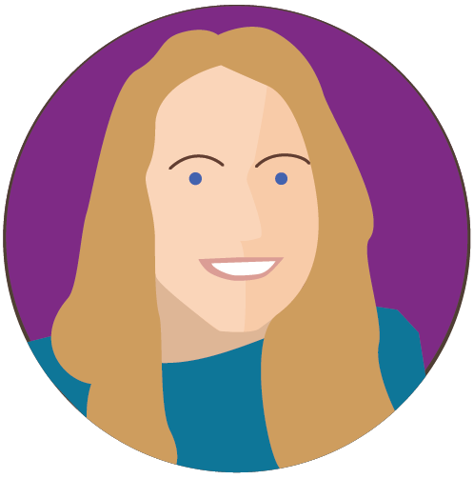
Danielle Gousse
Agricultural technologist
Grew up in Minnesota on a dairy farm
Enjoys whitewater kayaking and her burgeoning tropical fish tank
Notes:
Daniele Gousse grew up in Minnesota on a dairy farm. From her earliest days she was aware of technology and how it made productive farming possible. The understanding that her family's farm couldn't have run without milking, homogenization, and pasteurization equipment made her a natural to continue exploring the role of technology in modern farming. An Associate of Science in Animal Science and Management and a Master of Science in Computer Science gave her the educational foundation to really enact new ways of using technology in the daily operations of the farm. "I've always thought that farming should be just as progressive technologically as any other field. Why should farmers be any less willing to take advantage of technology than garbage collectors or taxi drivers? When Danielle's away from the farm, she enjoys whitewater kayaking and her burgeoning tropical fish tank.

Slide 7

Fernando Vasquez
Beekeeper
Worked in a bookstore in Passaic, NJ
A published poet and enthusiastic cabinetmaker
Notes:
Fernando Vasquez was working in a bookstore in Passaic, NJ, after studying Spanish literature when a co-worker and friend asked for help with a gardening project. The friend and his wife had decided they were going to try to grow their own food and needed some help preparing the yard. They had bought a hive of bees and the box was on a shaky platform. The son of a carpenter, Fernando threw himself into making a better platform for the bees and was amazed that working around the bees disturbed them so little. "I never knew before how different bees are from wasps. You can't do anything around a wasp, but bees really leave you alone, even if you're close by." As he helped his friends till the yard, he began to grasp how vital the bees were to the project and growing food in general. As he learned about bees and their behavior, he became hooked and soon had an apiary of his own. Fifteen years and many bee boxes later, he is beekeeper at Munson's. Fernando is also a published poet and enthusiastic cabinetmaker.

