Slide 1
Seasonal Overview

Slide 2
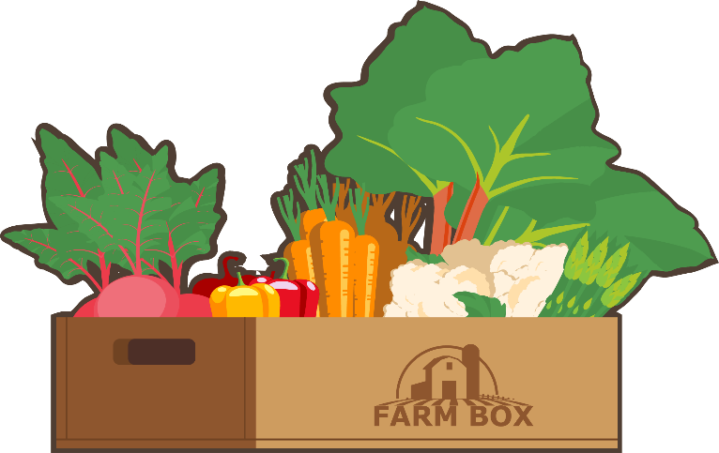
Spring Farm Box Produce

Slide 3
Spring Events

Slide 4
Spring Maintenance Projects

Slide 5
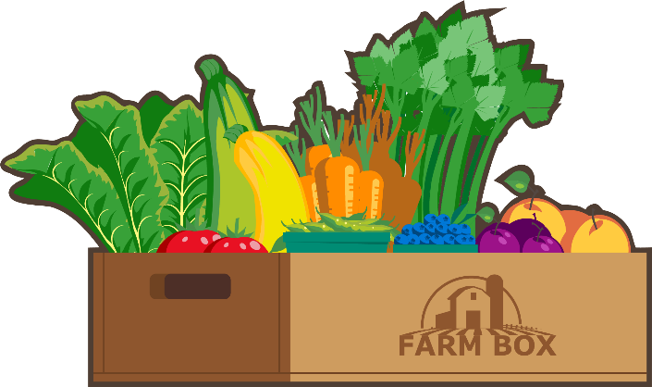
Summer Farm Box Produce

Slide 6
Summer Events

Slide 7
Summer Maintenance Projects

Slide 8
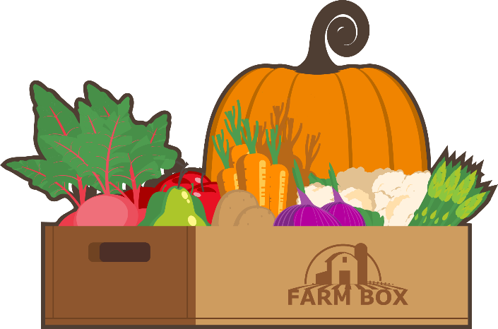
Autumn Farm Box Produce

Slide 9
Autumn Events

Slide 10
Autumn Maintenance Projects

Slide 11
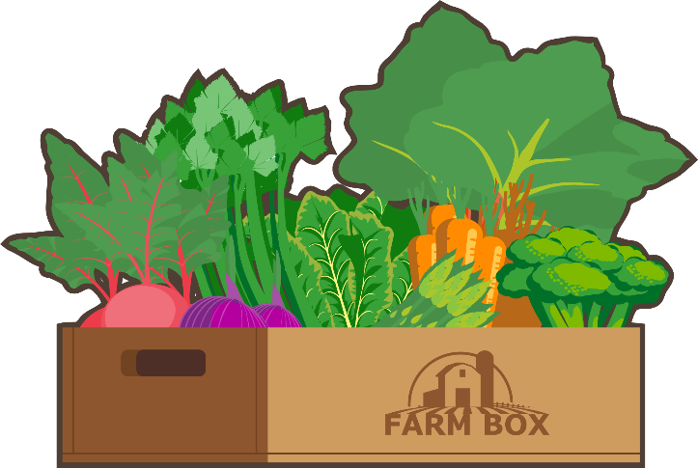
Winter Farm Box Produce

Slide 12
Winter Events

Slide 13
Winter Maintenance Projects

