Slide 1

The Best of Munson's

Slide 2

Recipes Needed
Bring your favorite recipes and a sample dish.
Winners will be featured in the next edition of the Munson’s cookbook.

Slide 3

Recipe Ideas
At Munson’s we are always looking for new recipes to feature in our cookbook editions.

Slide 4

Pickle recipes
Pickled cucumbers
Other pickled vegetables

Slide 5
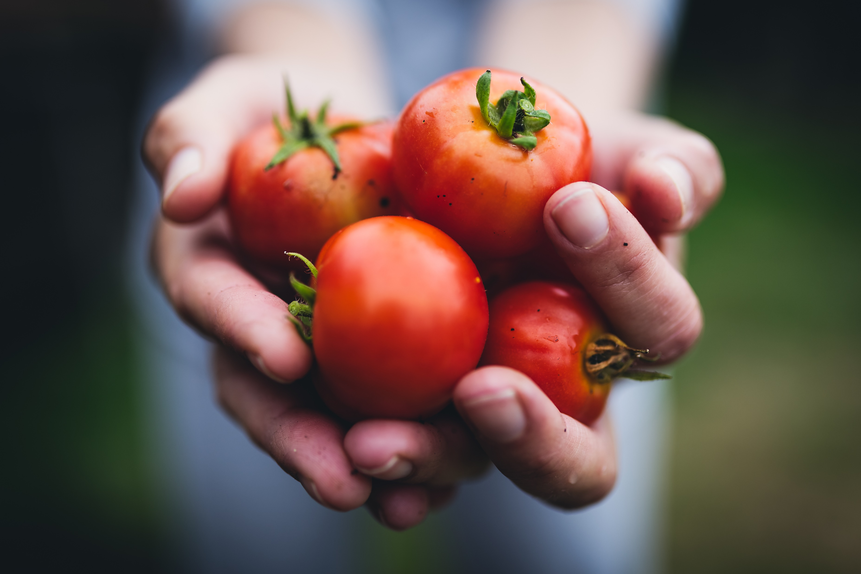
Featured Fruit
Dust off those family favorite recipes for the following featured fruit of the new edition of the Munson’s Cookbook.

Slide 6
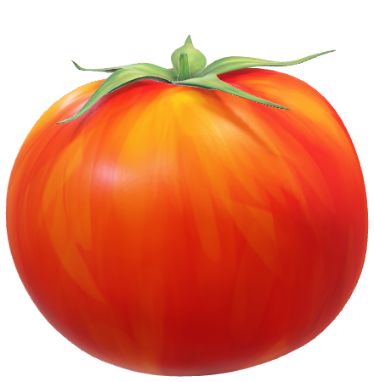
Tomatoes
Appetizers
Side dishes

Slide 7
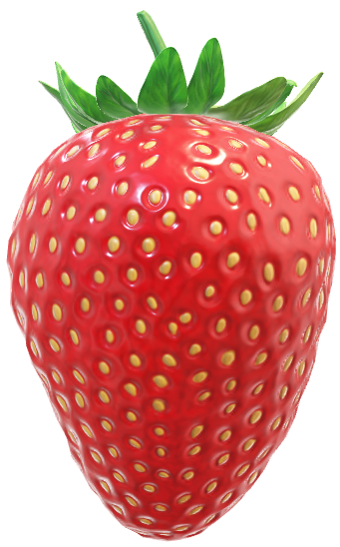
Strawberries
Preserves
Pies

Slide 8
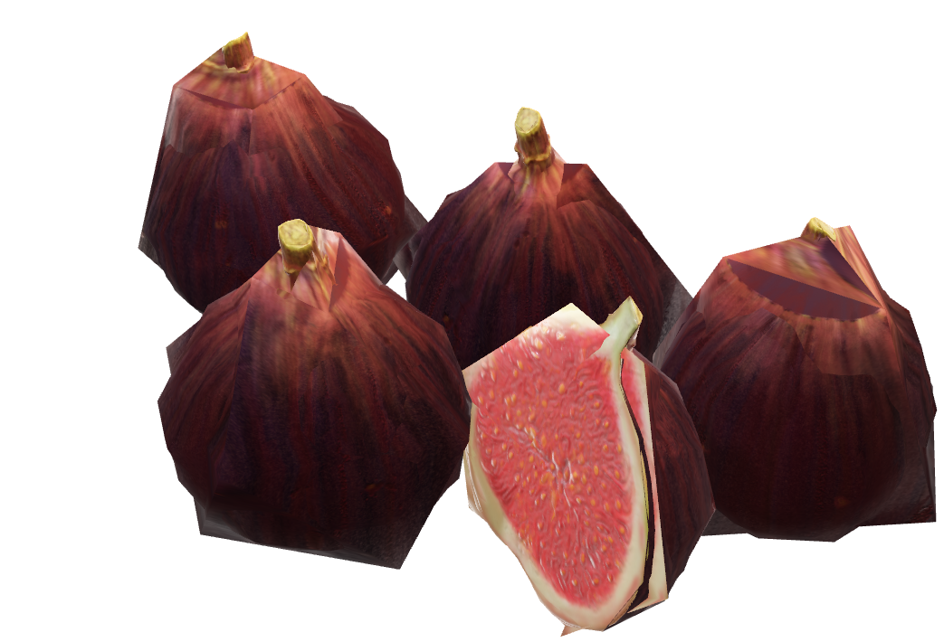
Figs
Appetizers
Jams

Slide 9
Additional Information
Munson's will provide
  The featured fruit for you to include in your recipes
  Basic cooking equipment
Please bring the following items
  Recipe
  Additional ingredients

Slide 10

See you Saturday!

